Slide 1
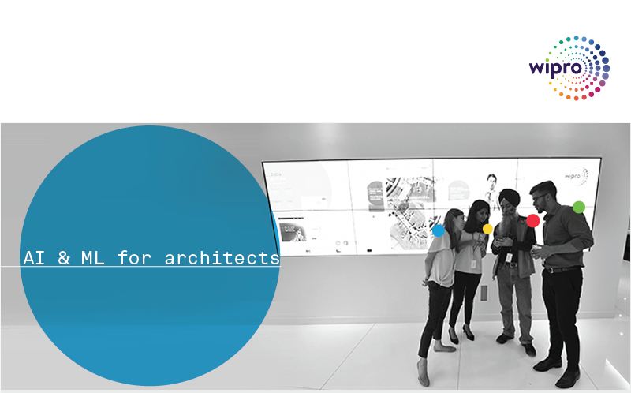
Introduction to AI and ML – Day 3 Gururajan Narasimhan Erode

Slide 2
Agenda for Day 3
Summary of our previous session
Neurons, Neural Networks and Deep Learning
Introduction to Neural Networks and Deep Learning
Need for Deep Learning
Forward Propagation Algorithm
Backward Propagation Algorithm
Convolutional Neural Networks, its architecture and working
Recurrent Neural Networks, its architecture and working
Applications of Convolution Neural Networks, Deep Neural Networks and Recurrent Neural Networks

Slide 3
Neural networks Why study neural networks and deep learning? We already so many techniques in conventional machine learning?
Whenever you have a problem that is difficult to solve look
towards nature - Albert Einstein

Slide 4
Need for Neural Networks and Deep Learning
Why do we need to have another type of Learning when we already have well proven and well understood traditional methods such as classification, regression and clustering?
As data increases beyond a certain limit the convention methods do not give provide good performance
The number of features that we use in traditional methods, grows exponentially large and we are not able to manage the inputs / features
Some problems are too complex to be solved by traditional machine learning techniques

Slide 5
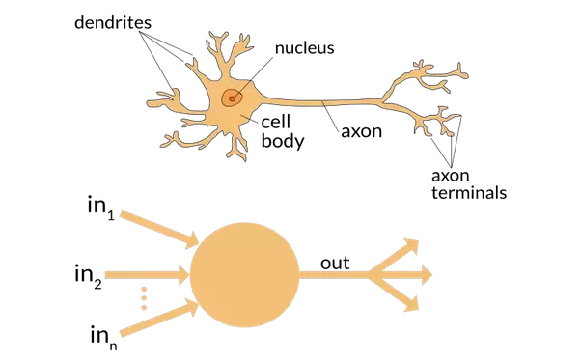

Slide 6
Neurons – what and where are they present?
Neurons are a very special type of brain cells that send signals among themselves and also into and out of the brain at close to 200 mph.
The neuron has a cell body (or soma) with dendrites branching (signal receivers) and a it also has a projection known as an axon, which conducts the signal
There are approximately 50 to 70 trillion cells in an adult humans body. A neuron is a special type of brain cell.
Out of the total 70 trillion cells, there are approximately 85 billion neurons (special cells) in our brain

Slide 7
Neurons – what do they carry ?
The signals coming from the auditory cortex, visual cortex and sensory cortex reach these neurons via the nerves that conduct these signals
Neurons have the wonderful capacity to collect and transmit electrochemical signals – we can imagine them as gates and the inputs and outputs of gates
Neurons share the same characteristics and have the same makeup as other cells, but the electrochemical aspect lets them transmit signals over long distances (up to several feet or a few meters) and send messages to each other.

Slide 8
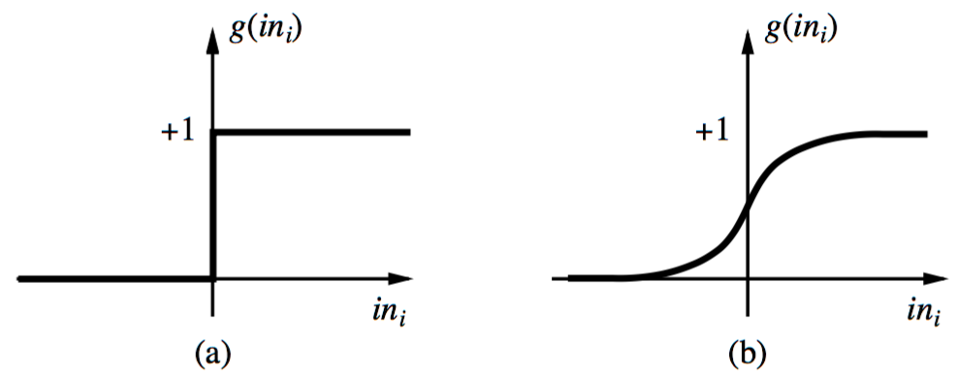
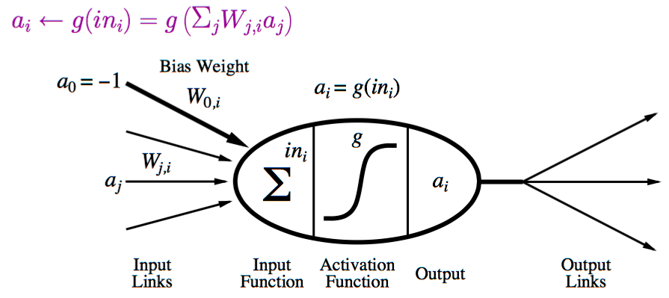
Neural Network: A Neuron, activation functions
A neuron can be thought of as a computational unit in the neural network that sends and receives messages from other neurons
Possible activation functions:
Step function/threshold function
Sigmoid function (a.k.a, logistic function)

Slide 9
Artificial Neural Networks and Deep Learning
Artificial neural network (ANN) - A computational model that is based on the functions and structure of neurons in our brain. We provide Information through the input nodes of the network which goes through the network. This affects the structure of the ANN, in the sense the neural network changes - or learns based on the input we give and the outputs it produces
Using Artificial Neural Networks, we can find complex non-linear relationships between the input and output. We could create a model and patterns can be found in the data. So ANNs are in a way a non-linear statistical modeling paradigm
In this context we can see deep learning as a technique where we have two or more than two layers in the neural network (the layers are deep)

Slide 10

Simple Neural Networks and a Deep Neural Network
picture credit: https://becominghuman.ai/deep-learning-made-easy-with-deep-cognition-403fbe445351

Slide 11
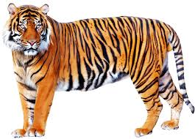
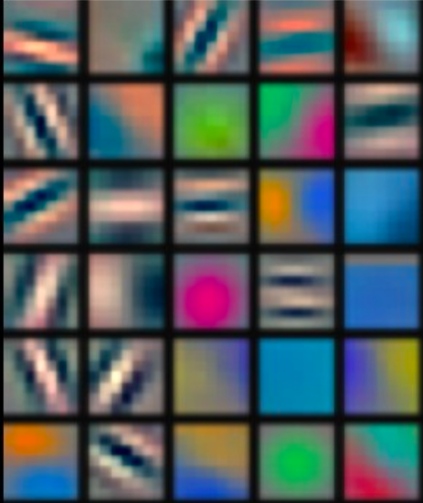
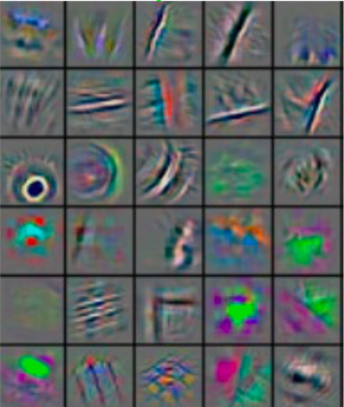
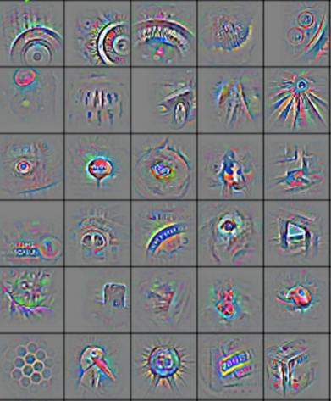
Deep Learning – for Image Classification
Deep learning (a.k.a. representation learning) seeks to learn rich hierarchical representations (i.e. features) automatically through multiple stage of feature learning process.
Low-level features
Mid-level features
High-level features
Trainable classifier
output
Feature visualization of convolutional net trained on ImageNet (Zeiler and Fergus, 2013)

Slide 12
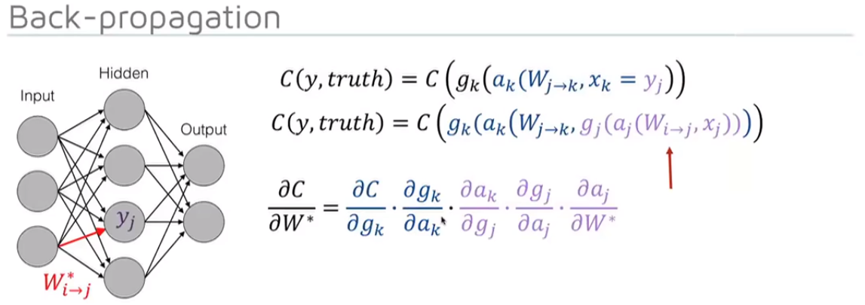
Forward Propagation and Back Propagation

Slide 13
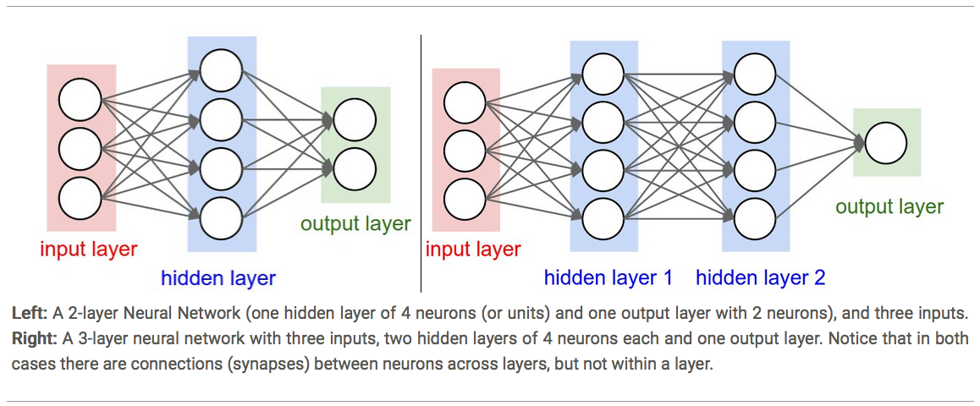
Picture credit: https://blog.liang2.tw/2015Talk-DeepLearn-CNN/?full#24

Slide 14
Convolutional Neural Network (CNN)
The inspiration for CNN comes from mammalian visual cortex
The visual cortex houses a complex arrangement of cells. They are sensitive to small sub-regions of the visual field, called a receptive field. These cells act as local filters over the input space and are well-suited to exploit the strong spatially local correlation present in natural images
Two basic cell types
Simple cells respond maximally to specific edge-like patterns within their receptive field
Complex cells have larger receptive fields and are locally invariant to the exact position of the pattern

Slide 15
CNN Architecture
Intuition: Neural network with specialized connectivity structure,
Stacking multiple layers of feature extractors
Low-level layers extract local features.
High-level layers extract learn global patterns.
A CNN consists of a list of layers that transform the input data into an output class/prediction.
There are a few distinct types of layers:
Convolutional layer
Pooling layer
Non-linear layer
Fully Connected layer

Slide 16
Convolutional Neural Network (CNN)
Convolution is a mathematical operation that does the integral of the product of 2 functions (signals), with one of the signals flipped. For example below we convolve 2 signals f(t) and g(t)
People use convolution on signal processing for the following use cases:
Filter signals (1D audio, 2D image processing)
Check how much a signal is correlated to another
Find patterns in signals
https://brilliant.org/wiki/convolutional-neural-network/

Slide 17
Convolutional Neural Networks
Convolutional neural networks (convnets, CNNs) are a powerful type of neural network that is used primarily for image classification. CNNs were originally designed by Geoffery Hinton, one of the pioneers of Machine Learning.
Their location invariance makes them ideal for detecting objects in various positions in images.
Google, Facebook, Snapchat and other companies that deal with images all use convolutional neural networks.
https://brilliant.org/wiki/convolutional-neural-network/

Slide 18
Convolutional Neural Networks
Convnets consist primarily of four different types of layers: convolutions, max-pooling layers, non-linear layer and one fully connected layer.
In the convolutional layers, a matrix known as a kernel is passed over the input matrix to create a feature map for the next layer.
The dimensions of the kernel can also be adjusted to produce a different feature map, or to expand the data along one dimension while reducing its size along the other axes.
https://brilliant.org/wiki/convolutional-neural-network/

Slide 19
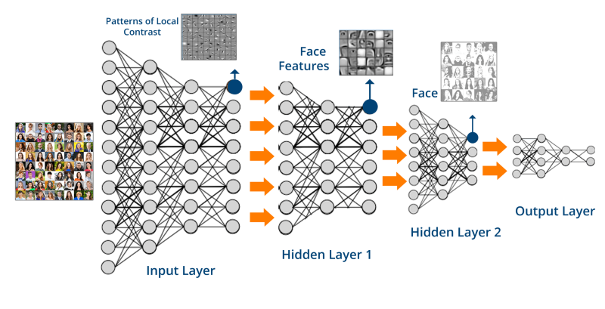
Picture credit: https://towardsdatascience.com/creating-a-movie-recommender-using-convolutional-neural-networks-be93e66464a7

Slide 20
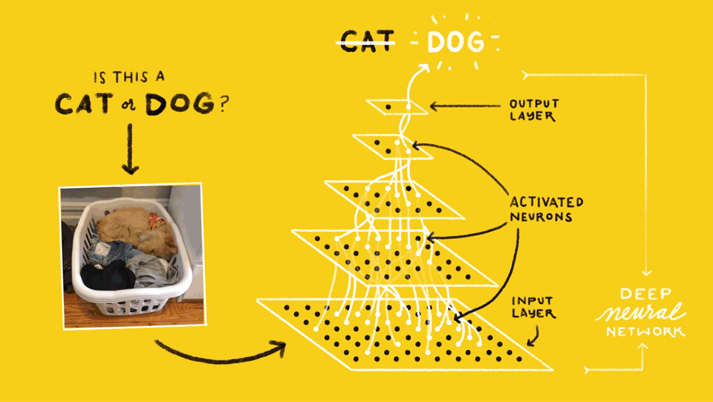
Picture credit: https://towardsdatascience.com/deep-learning-with-tensorflow-part-1-b19ce7803428

Slide 21
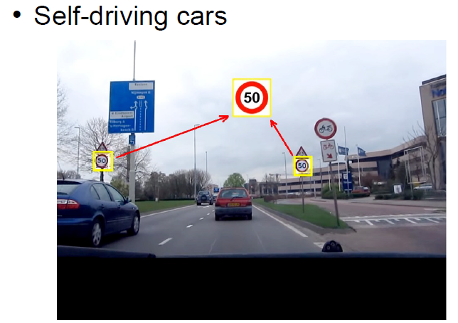
Speed sign detection in a moving car on a highway in day and at night
https://www.youtube.com/watch?v=kkha3sPoU70

Slide 22
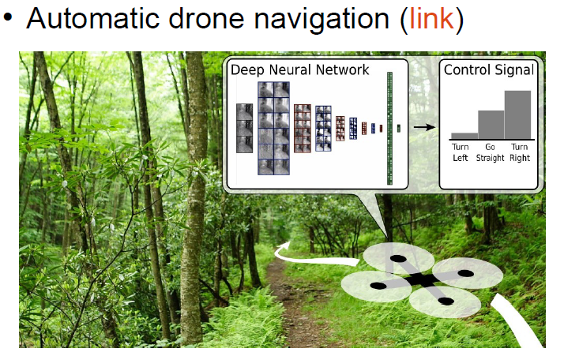
Automatic drone navigation - link
https://www.youtube.com/watch?v=_qah8oIzCwk
Digits recognition using CNN
https://cs.stanford.edu/people/karpathy/convnetjs/demo/mnist.html

Slide 23
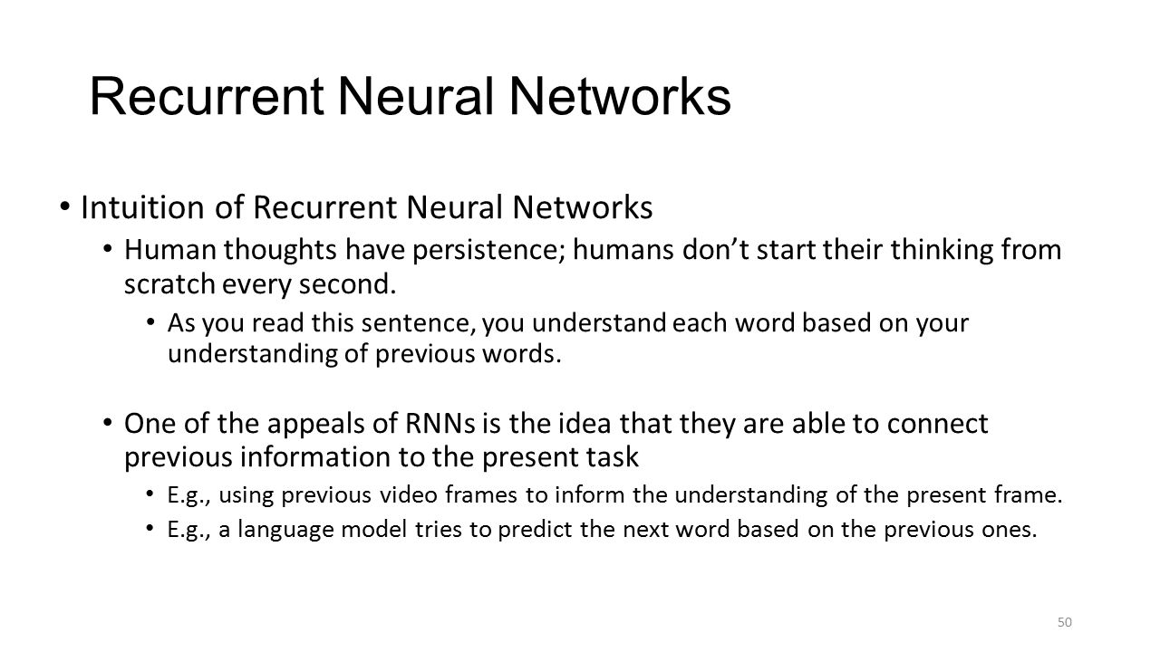

Slide 24
Recurrent neural networks
Because they can model temporal sequences of input-output pairs, recurrent neural networks have found enormous success in natural language processing (NLP) applications.
This includes machine translation, speech recognition, and language modeling. RNNs have also been used in reinforcement learning to solve very difficult problems at a level better than humans.
A recent example is AlphaGo, which beat world champion Go player Lee Sedol in 2016.

Slide 25
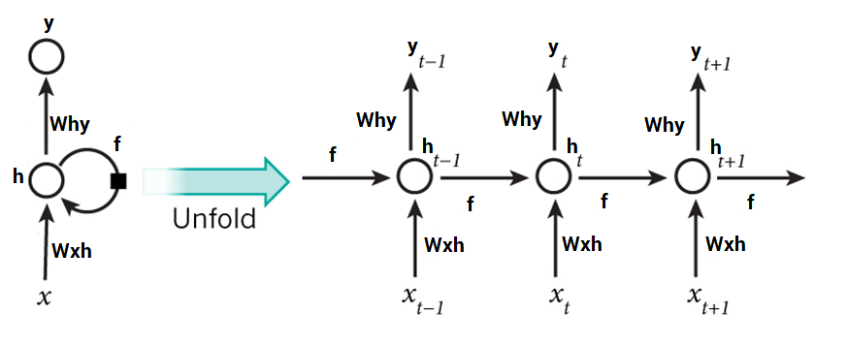
Picture credit http://www.wildml.com/2015/09/recurrent-neural-networks-tutorial-part-1-introduction-to-rnns/

Slide 26
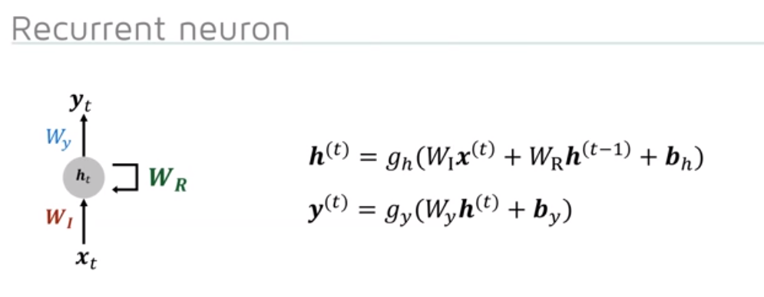

Slide 27
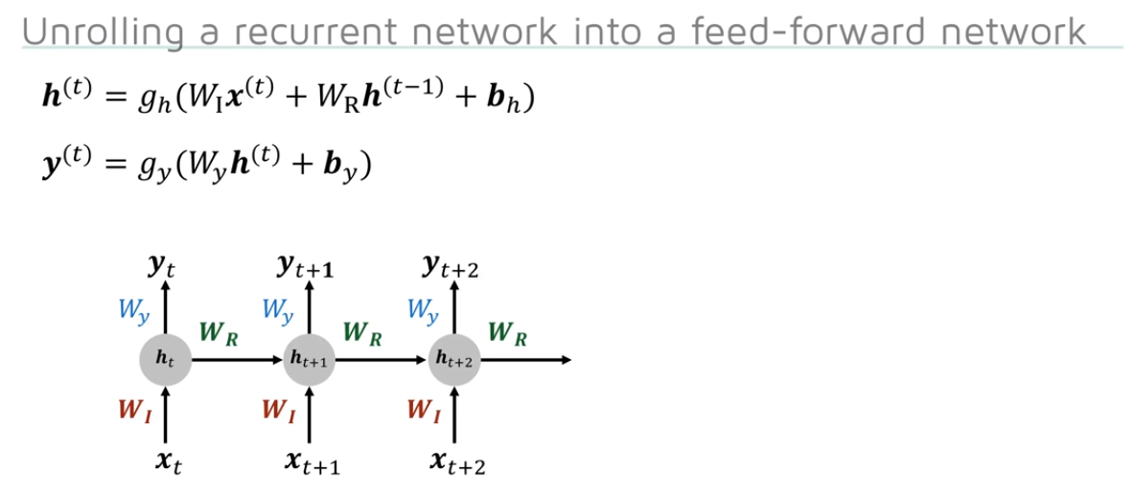

Slide 28
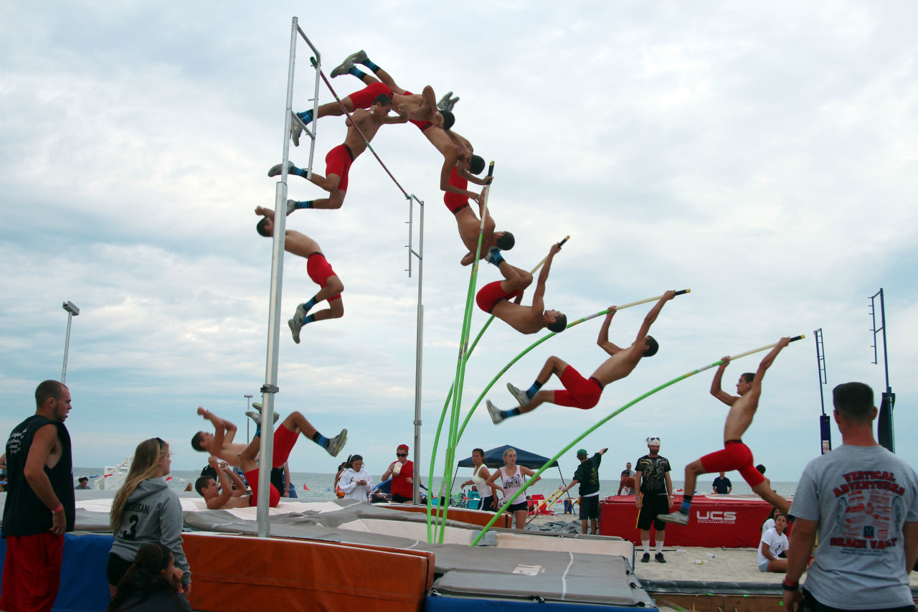
Recurrent Neural Networks – RNN –previous video frames used to understand the next one

Slide 29
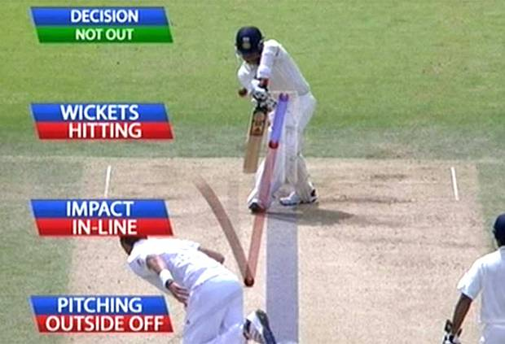
Recurrent Neural Networks – RNN – used in DRS – Decision Review System

Slide 30
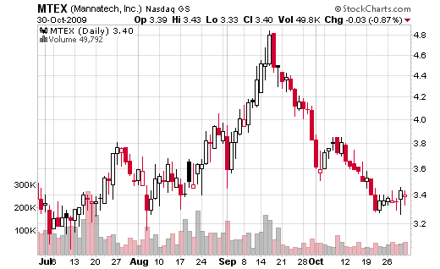
Recurrent Neural Networks in understanding stock prices

Slide 31
References – Recurrent Neural Networks
Simple use-case for Recurrent Neural Networks – predicting the next word in sentence - https://www.youtube.com/watch?v=y7qrilE-Zlc
Sequence Models in Recurrent Neural Networks https://www.youtube.com/watch?v=SBTbLN1W1RY
Generating sound for slient videos https://boingboing.net/2016/06/13/artificial-intelligence-create.html
Building RNNs using Tensor Flow - Sentdex https://www.youtube.com/watch?v=dFARw8Pm0Gk

Slide 32
References – Convolutional Neural Networks
Speed Sign Recognition by Convolutional Neural Networks - Part 1 https://www.youtube.com/watch?v=kkha3sPoU70
Speed Sign Recognition by Convolutional Neural Networks - Part 2 https://www.youtube.com/watch?v=UrWAeukkLdk
Drone Autonomously Avoiding Obstacles at 30 MPH https://www.youtube.com/watch?v=_qah8oIzCwk
Autonomous robotic plane flies indoors at MIT https://www.youtube.com/watch?v=kYs215TgI7c
Quadcopter Navigation in the Forest using Deep Neural Networks https://www.youtube.com/watch?v=umRdt3zGgpU

Slide 33
Credits for pictures, acknowledgements for definitions and descriptions
https://www.blackhat.com/docs/ldn-15/materials/london-15-Weedon-Deconstructing-Kony-Android-Apps.pdf
www.asiarubtechexpo2018.com/sites/default/files/62.%20Tirthankar%20Bhandary%20-20Quantitative%20estimation%20of%20Antioxidants%20....pdf
https://www.theicct.org/sites/default/files/RHooda_0.pdf

